Slide 1
Expert System
UNIT-6

Slide 2
outline
Introduction
Knowledge Acquisition
Knowledge Base
Working Memory
Inference Engine
Expert System Shells
Application of Expert systems

Slide 3
Introduction
An expert system is an interactive computer-based decision tool that
uses both facts and heuristics to solve difficult decision problems, based
on knowledge acquired from an expert.
A model and associated procedure that exhibits, within a specific
domain, a degree of expertise in problem solving that is comparable to that of a human expert.

Slide 4
Cond…
Inference engine + Knowledge = Expert system
( Algorithm + Data structures = Program in traditional computer )
First expert system, called DENDRAL, in the early 70's was developed by Stanford University.

Slide 5
Cond…
Expert system components and human interfaces
Expert systems have a number of major system components and interface with individuals in various roles. These are illustrated below.

Slide 6
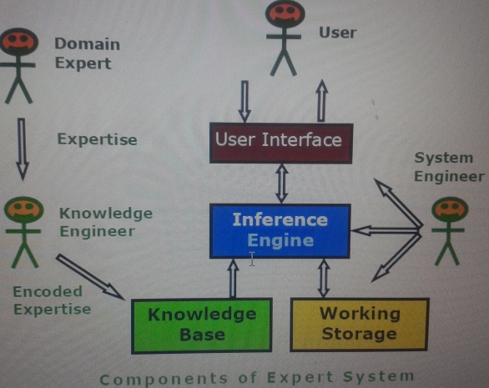

Slide 7
Components and Interfaces
Knowledge base : a declarative representation of the expertise; often IF THEN rules;
Working storage : the data; specific to a problem being solved;
Inference engine : the code at the core of the system; derives recommendations from the knowledge base and problem-specific data in working storage;
User interface : the code that controls the dialog between the user and the system.

Slide 8
Roles of individuals who interact with the system
Domain expert : the individuals who currently are experts solving the problems, here the system is intended to solve;
Knowledge engineer : the individual who encodes the expert's knowledge in a declarative form that can be used by the expert system;
User : the individual who will be consulting with the system to get advice which would have been provided by the expert.

Slide 9
Expert system shells
Many expert systems are built with products called expert system shells. The shell is a piece of software which contains the
User interface,
A format for declarative knowledge in the knowledge base,
An inference engine.

Slide 10
Contd…
Knowledge engineer : uses the shell to build a system for a particular problem domain.
System engineer : the individual who builds the user interface, designs the declarative format of the knowledge base, and implements the inference engine.
Depending on the size of the system, the knowledge engineer and the system engineer might be the same person.

Slide 11
Expert system Characteristics
Operates as an interactive system : This means
responds to questions
asks for clarifications
makes recommendations
aids the decision-making process.
Tools have ability to store and select (filter) knowledge
storage and retrieval of knowledge
mechanisms to expand and update knowledge base on a continuing basis

Slide 12
Contd…
Capability to make logical inferences based on knowledge stored
simple reasoning mechanisms is used
KB with means of exploiting the knowledge stored, else it is not useful
learning all the words in a language, without knowing how to combine those words to form a meaningful sentence. (Dictionary)

Slide 13
Contd…
Ability to explain reasoning
remembers logical chain of reasoning therefore user may ask
for explanation of a recommendation
factors considered in recommendation
enhances user confidence in recommendation and acceptance of expert system
Systems are very domain-specific
a particular system caters a narrow area of specialization; a medical expert system cannot be used to find faults in an electrical circuit
quality of advice offered by an expert system is dependent on the amount of knowledge stored.

Slide 14
Contd…
Capability to assign of confidence values
can deliver quantitative information
can interpret qualitatively derived values
can address imprecise and incomplete data through assignment of confidence values
Best suited applications for expert systems
for those dealing with expert heuristics for solving problems.
not a suitable choice for those problems that can be solved using purely numerical techniques.

Slide 15
Contd…
Cost-effective alternative to human expert
Expert systems have become increasingly popular because of their specialization, although in a narrow field.
The small size of the domain makes encoding and storing the domain specific knowledge an economic process.
specialists in many areas are scarce, and the cost of consulting them is high, an expert system catering to any of those areas can be considered to be a useful and cost-effective alternative, in the long run.

Slide 16
Expert System Features
Goal driven reasoning or backward chaining : an inference technique which uses IF THEN rules to repetitively break a goal into smaller sub-goals which are easier to prove;
Coping with uncertainty : the ability of the system to reason with rules and data which are not precisely known;
Data driven reasoning or forward chaining : an inference technique which uses IF THEN rules to deduce a problem solution from initial data;

Slide 17
Contd…
Data representation : the way in which the problem specific data in the system is stored and accessed;
User interface : that portion of the code which creates an easy to use system;
Explanations : the ability of the system to explain the reasoning process that it used to reach a recommendation.

Slide 18
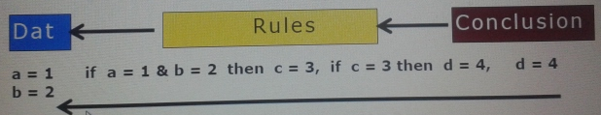
Goal-Driven Reasoning
Goal-driven reasoning, or backward chaining, is an efficient way to solve problems. The Backward chaining or goal driven algorithm proceeds from desired goal, adding new assertions found.

Slide 19
Contd…
The knowledge is structured in rules which describe how each of the possibilities might be selected. The rule breaks the problem into sub problems.
Example :
KB contains rule set
Rule 1: if A and C then F
Rule 2: if A and E then G
Rule 3: if B then E
Rule 4: if G then D
Problem : prove
if A and B true then D is true

Slide 20
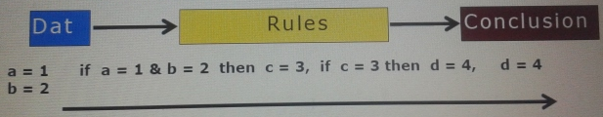
Data Driven Reasoning
The data driven approach, or Forward chaining, uses rules similar to those used for backward chaining. However, the inference process is different.
The system keeps track of the current state of problem solution and looks for rules which will move that state closer to a final solution
The Algorithm proceeds from given situation to desired goal, adding new assertions found.

Slide 21
Knowledge Acquisition
Knowledge acquisition includes the elicitation (draw out from someone), collection, analysis, demonstrating (modelling) and validation of knowledge.

Slide 22
Issues in Knowledge Acquisition
The important issues in knowledge acquisition are:
■ knowledge is in the head of experts
■ Experts have vast amounts of knowledge
■ Experts have a lot of unspoken (tacit) knowledge
They do not know all that they know and use
Unspoken knowledge is hard (impossible) to describe
■ Experts are very busy and valuable people
■ One expert does not know everything
■ Knowledge has a "shelf life“

Slide 23
Techniques for Knowledge Acquisition
■ Protocol-generation techniques include various types of
Interviews (unstructured, semi-structured and structured),
Reporting and observational techniques.
■ Protocol analysis techniques are used with transcripts
of interviews or text-based information to identify basic knowledge objects within a protocol,
such as goals, decisions, relationships and attributes.
This acts as a bridge between the use of protocol-based techniques and knowledge modelling techniques.

Slide 24
contd…
■ Hierarchy-generation techniques (laddering techniques) involve
creation, reviewing and modification of hierarchical knowledge.
the techniques are used to build hierarchical structures such as goal trees and decision networks.
The Ladders are of Various forms like concept ladder, attribute ladder, composition ladders.
■ Matrix-based techniques involve the construction of grids
indicating such things as problems encountered against possible solutions.
Important types include the use of frames for representing the properties of concepts

Slide 25
Contd…
■ Sorting techniques are used for capturing the way people compare and order concepts, and can lead to the disclosure of knowledge about classes, properties and priorities.
■ Limited-information and constrained-processing tasks are techniques that either limit the time and/or information available to the expert when performing tasks.
For instance, the twenty questions technique provides an efficient way of accessing the key information in a domain in a prioritized order.
■ Diagram-based techniques include the generation and use of concept maps, state transition networks, event diagrams and process maps.
The use of these is particularly important in capturing the
"what, how, when, who and why" of tasks and events.

Slide 26
Knowledge Base
Expert system is built around knowledge base module. It contains the formal representation of the information provided by the domain expert. This information may be in the form of problem-solving rules, procedures, or data intrinsic to the domain.
To incorporate this information into the system, it is necessary to make use of one or more knowledge representation methods.
Transferring knowledge from the human expert to a computer is often the most difficult part of building an expert system.

Slide 27
Contd…
The knowledge acquired from the human expert must be encoded in such a way that it remains a faithful representation of what the expert knows, and it can be manipulated by a computer.
Three common methods of knowledge representation evolved over the years are IF-THEN rules, semantic networks and frames.

Slide 28
If-Then rules
Human experts usually tend to think along
condition ⇒ action or Situation ⇒ conclusion
Rules "if-then" are predominant form of encoding knowledge in expert systems. These are of the form :
If a1, a2, . . . . . , an
Then b1, b2, . . . . . , bn
where each “ai” is a condition or situation, and each “bi” is an action or a conclusion.

Slide 29
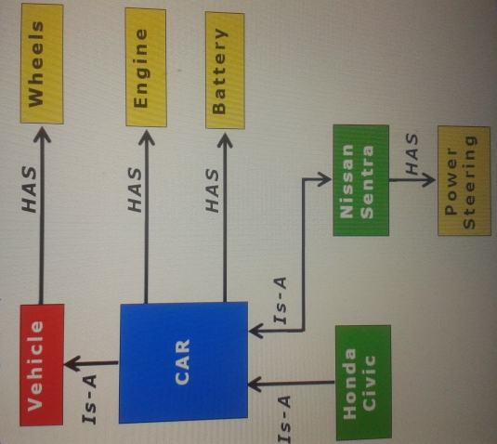
Semantic networks

Slide 30
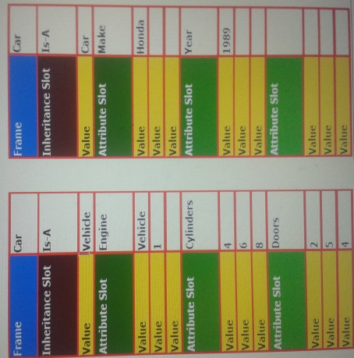
Frames

Slide 31
Working Memory
Working memory refers to task-specific data for a problem. The contents of the working memory, changes with each problem situation.
Consequently, it is the most dynamic component of an expert system, assuming that it is kept current.

Slide 32
Contd…
Every problem in a domain has some unique data associated with it.
Data may consist of the set of conditions leading up to the problem, its parameters and so on.
Data specific to the problem needs to be input by the user at the time of consulting the expert system.
Next Figure shows how Working memory is closely related to user interface of the expert system.

Slide 33
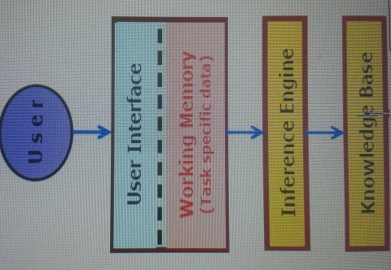
Contd…

Slide 34
Inference Engine
It is generic control mechanism for navigating through and manipulating knowledge and deduce results in an organized manner.
Forward chaining, Backward chaining and Tree searches are some techniques for drawing inferences from knowledge base.

Slide 35
Expert System Shells
An Expert system shell is a software development environment. It contains the basic components of expert systems.
A shell is associated with a prescribed method for building applications by configuring and instantiating these components.

Slide 36
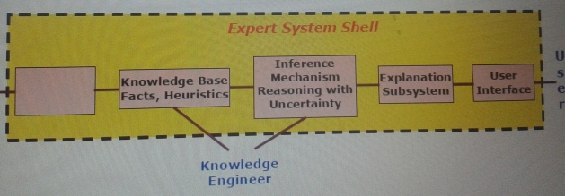
Condd…

